Slide 1
Lexical Semantics
Week 8, Lecture 1

Slide 2
Lexical Semantics
Definition
Lexical semantics is concerned with the systematic meaning related connections among lexical items, and the internal meaning-related structure of individual lexical items.
To identify the semantics of lexical items, we need to focus on the notion of
lexeme, an individual entry in the lexicon.
What is a lexeme?
Lexeme should be thought of as a pairing of a particular orthographic and phonological form with some sort of symbolic meaning representation.
Orthographic form, and phonological form refer to the appropriate form part of a lexeme
Sense refers to a lexeme’s meaning counterpart.
Week 8, Lecture 1
2 / 18

Slide 3
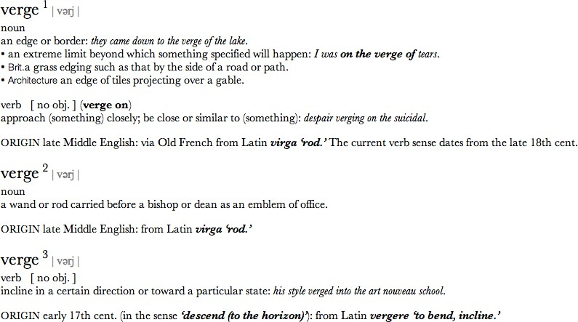
Example
Week 8, Lecture 1

Slide 4
Example: meaning related facts?
Definitions from the American Heritage Dictionary (Morris, 1985)
right adj. located near the right hand esp. being on the right when facing the same direction as the observer
left adj. located near to this side of the body than the right
red n. the color of blood or a ruby
blood n. the red liquid that circulates in the heart, arteries and veins of animals
The entries are description of lexemes in terms of other lexemes
Definitions make it clear that right and left are similar kind of lexemes that stand in some kind of alternation, or opposition, to one another
We can glean that red is a color, it can be applied to both blood and
rubies, and that blood is a liquid.
Week 8, Lecture 1
4 / 18

Slide 5
Relations between word meanings
Homonymy Polysemy Synonymy Antonymy Hypernymy Hyponymy Meronymy
Week 8, Lecture 1

Slide 6
Homonymy
Definition
Homonymy is defined as a relation that holds between words that have the same form with unrelated meanings.
Examples
Bat (wooden stick-like thing) vs Bat (flying mammal thing) Bank (financial institution) vs Bank (riverside)
homophones and homographs
homophones are the words with the same pronunciation but different spellings.
write vs right piece vs peace
homographs are the lexemes with the same orthographic form but different meaning. Ex: bass
Week 8, Lecture 1
6 / 18

Slide 7
Problems for NLP applications
Text-to-Speech
Same orthographic form but different phonological form
Information Retrieval
Different meaning but same orthographic form
Speech Recognition
to, two, too
Perfect homonyms are also problematic
Week 8, Lecture 1
7 / 18

Slide 8
Polysemy
Multiple related meanings within a single lexeme.
The bank was constructed in 1875 out of local red brick. I withdrew the money from the bank.
Are those the same sense?
Sense 1: “The building belonging to a financial institution”
Sense 2: “A financial institution”
Another example
Heavy snow caused the roof of the school to collapse. The school hired more teachers this year than ever before.
Week 8, Lecture 1
8 / 18

Slide 9
Polysemy: multiple related meanings
Often, the relationships are systematic
E.g., building vs. organization
school, university, hospital, church, supermarket
More examples:
Author (Jane Austen wrote Emma) ↔ Works of Author (I really love Jane Austen)
Animal (The chicken was domesticated in Asia) ↔ Meat (The chicken was overcooked)
Tree (Plums have beautiful blossoms) ↔ Fruit (I ate a preserved plum yesterday)
Week 8, Lecture 1
9 / 18

Slide 10
Polysemy: multiple related meanings
Zeugma test
Which of these flights serve breakfast? Does Midwest Express serve Philadelphia?
*Does Midwest Express serve breakfast and San Jose?
Combine two separate uses of a lexeme into a single example using conjunction
Since it sounds weird, we say that these are two different senses of serve.
Week 8, Lecture 1
10 / 18

Slide 11
Synonymy
Words that have the same meaning in some or all contexts.
filbert / hazelnut couch / sofa
big / large automobile / car vomit / throw up water / H₂O
Two lexemes are synonyms if they can be successfully substituted for each other in all situations.
Week 8, Lecture 1

Slide 12
Synonymy: A relation between senses
Consider the words big and large.
Are they synonyms?
How big is that plane?
Would I be flying on a large or small plane?
How about here?
Miss Nelson, for instance, became a kind of big sister to Benjamin.
*Miss Nelson, for instance, became a kind of large sister to Benjamin.
Why?
big has a sense that means being older, or grown up
large lacks this sense
Week 8, Lecture 1
12 / 18

Slide 13
Synonyms
Shades of meaning
What is the cheapest first class fare?
*What is the cheapest first class price?
Collocational constraints
We frustate ’em and frustate ’em, and pretty soon they make a big
mistake.
*We frustate ’em and frustate ’em, and pretty soon they make a large
mistake.
Week 8, Lecture 1
13 / 18

Slide 14
Antonyms
Senses that are opposites with respect to one feature of their meaning Otherwise, they are similar!
dark / light
short / long
hot / cold
up / down
in / out
More formally: antonyms can
define a binary opposition or at opposite ends of a scale (long/short,
fast/slow )
Be reversives: rise/fall
Week 8, Lecture 1
14 / 18

Slide 15
Hyponymy and Hypernymy
Hyponymy
One sense is a hyponym of another if the first sense is more specific, denoting a subclass of the other
car is a hyponym of vehicle dog is a hyponym of animal mango is a hyponym of fruit
Hypernymy
Conversely
vehicle is a hypernym/superordinate of car animal is a hypernym of dog
fruit is a hypernym of mango
Week 8, Lecture 1
15 / 18

Slide 16
Hyponymy more formally
Entailment
Sense A is a hyponym of sense B if being an A entails being a B. Ex: dog, animal
Transitivity
A hypo B and B hypo C entails A hypo C
Week 8, Lecture 1

Slide 17
Meronyms and holonyms
Definition
Meronymy: an asymmetric, transitive relation between senses.
X is a meronym of Y if it denotes a part of Y. The inverse relation is holonymy.
meronym | holonym
porch | house
wheel | car
leg | chair
nose | face
Week 8, Lecture 1

Slide 18
Lexical Semantics - WordNet
Week 8, Lecture 2

Slide 19
WordNet
https://wordnet.princeton.edu/wordnet/
A hierarchically organized lexical database
A machine-readable thesaurus, and aspects of a dictionary Versions for other languages are under development
part of speech | no. synsets
noun | 82,115
verb | 13,767
adjective | 18,156
adverb | 3,621
Week 8, Lecture 2

Slide 20
Synsets in WordNet
A synset is a set of synonyms representing a sense
Example: chump as a noun to mean ‘a person who is gullible and easy to take advantage of’
Each of these senses share this same gloss.
For WordNet, the meaning of this sense of chump is this list.
Week 8, Lecture 2

Slide 21
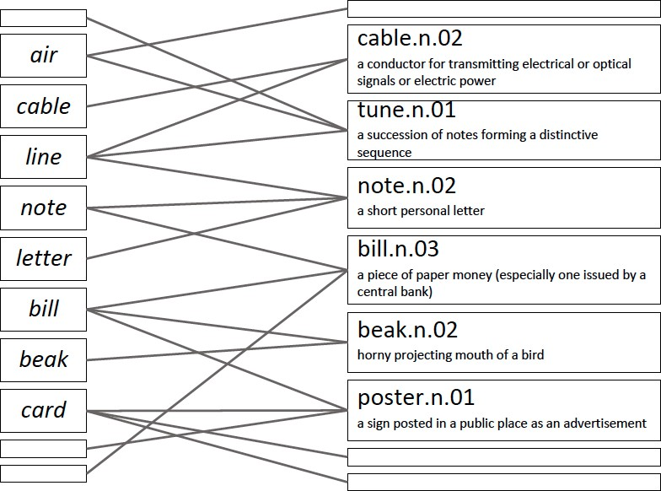
lemma vs. synsets
Week 8, Lecture 2

Slide 22
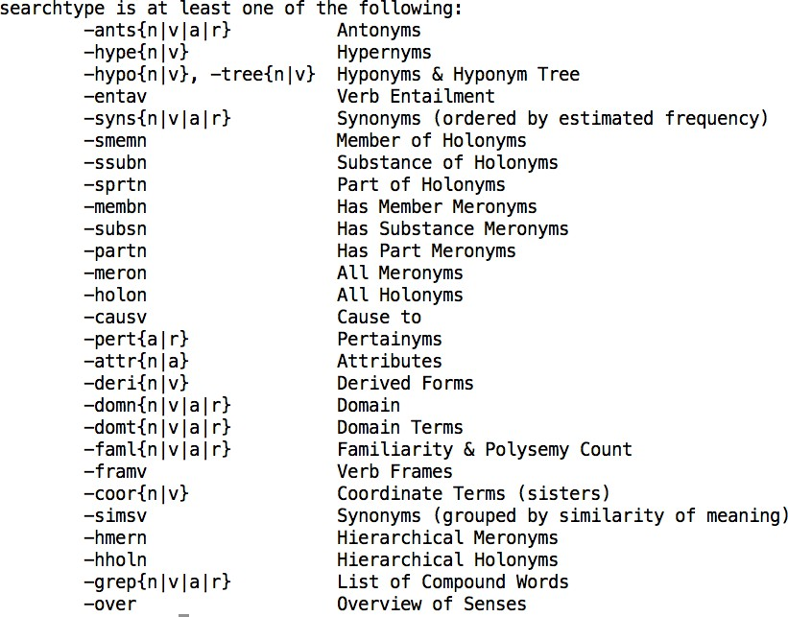
All relations in WordNet
Week 8, Lecture 2

Slide 23
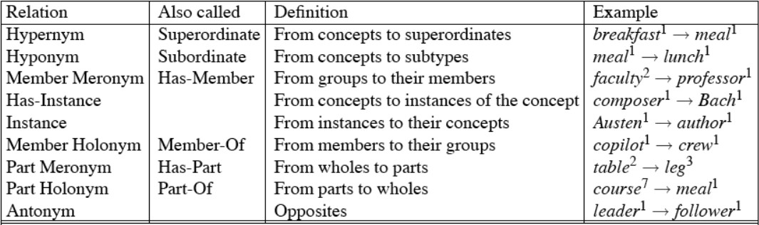
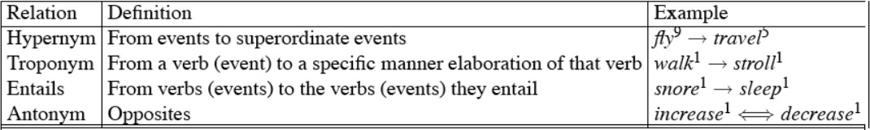
Wordnet noun and verb relations
Week 8, Lecture 2

Slide 24
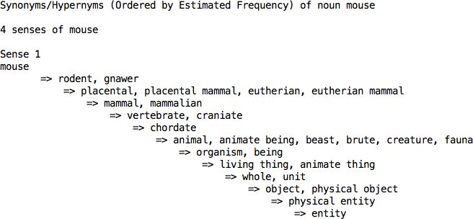
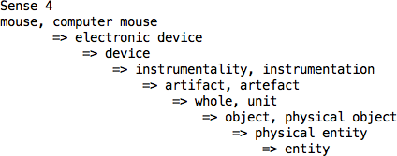
WordNet Hierarchies
Week 8, Lecture 2

Slide 25
Word Similarity
Synonymy is a binary relation
Two words are either synonymous or not
We want a looser metric
Word similarity or
Word distance
Two words are more similar
If they share more features of meaning
Actually these are really relations between senses:
Instead of saying “bank is like fund”
We say
^{F} Bank¹ is similar to fund³
^{F} Bank² is similar to slope⁵
We will compute similarity over both words and senses
Week 8, Lecture 2

Slide 26
Two classes of algorithms
Distributional algorithms
By comparing words based on their distributional context in the corpora
Thesaurus-based algorithms
Based on whether words are “nearby” in WordNet
Lexical Semantics - WordNet
Week 8, Lecture 2

Slide 27
Thesaurus-based Word Similarity
We could use anything in the thesaurus:
Meronymy, hyponymy, troponymy
Glosses and example sentences
In practice, “thesaurus-based” methods usually use:
the is-a/subsumption/hypernymy hierarchy
and sometimes the glosses too
Word similarity vs. word relatedness
Similar words are near-synonyms
Related words could be related any way
^{F} car, gasoline : related, but nor similar
^{F} car, bicycle: similar
Week 8, Lecture 2
10 / 27

Slide 28
Path-based similarity
Basic Idea
Two words are similar if they are nearby in the hypernym graph
pathlen(c₁, c₂) = number of edges in shortest path (in hypernym graph) between senses c₁ and c₂
sim_{path}(c₁, c₂) = ₁
1
+pathlen(c1,c2)
^{sim(w}1^{, w}2^{) = max}c1∈senses(w1),c2∈senses(w2)^{sim(c}1^{, c}2⁾
Week 8, Lecture 2
11 / 27

Slide 29
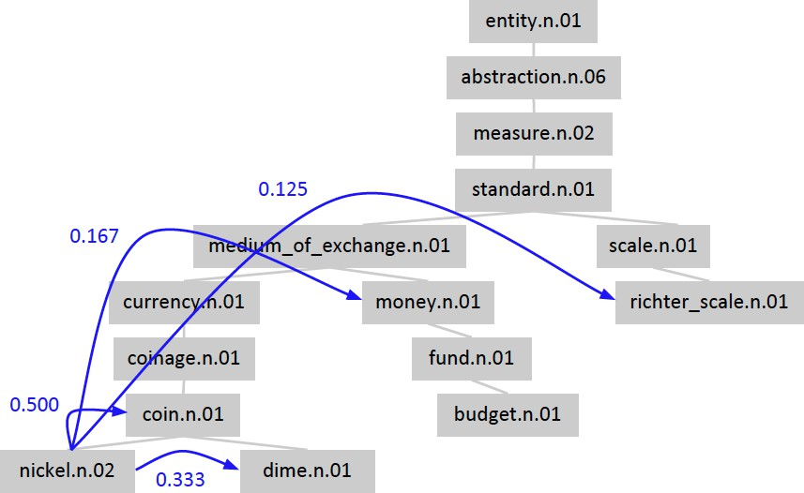
Shortest path in the hierarchy
Week 8, Lecture 2

Slide 30
Leacock-Chodorow (L-C) Similarity
L-C similarity
sim_{LC}(c₁, c₂) = −log(pathlen(c₁, c₂)/2d) d: maximum depth of the hierarchy
Problems with L-C similarity
Assumes each edge represents a uniform distance ‘nickel-money’ seems closer than ‘nickel-standard’
We want a metric which lets us assign different “lengths” to different edges - but how?
Week 8, Lecture 2
13 / 27

Slide 31
Concept probability models
Cencept probabilities
For each concept (synset) c, let P(c) be the probability that a randomly selected word in a corpus is an instance (hyponym) of c
P(ROOT) = 1
The lower a node in the hierarchy, the lower its probability
Estimating concept probabilities
Train by counting “concept activations” in a corpus
Each occurrence of dime also increments counts for coin, currency, standard, etc.
Week 8, Lecture 2
14 / 27

Slide 32
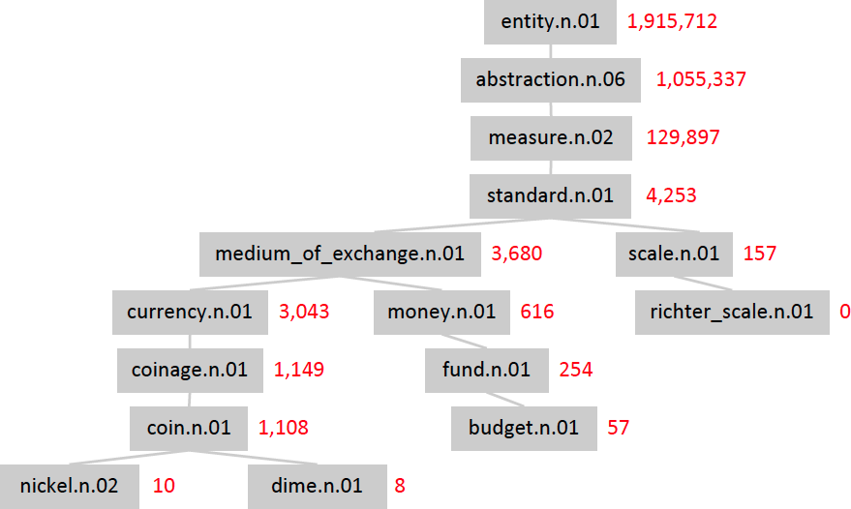
Example : concept count
Week 8, Lecture 2

Slide 33
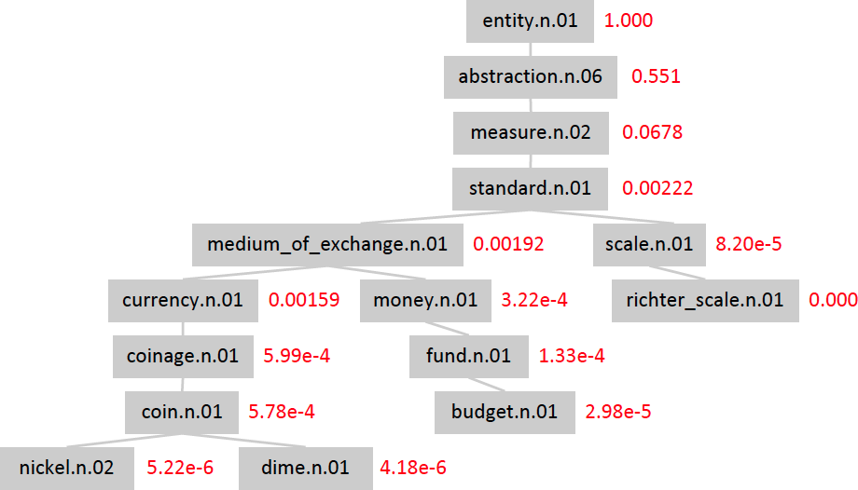
Example : concept probabilities
Week 8, Lecture 2

Slide 34
Information content
Information content
Information content: IC(c) = −logP(c)
Lowest common subsumer : LCS(c₁, c₂): the lowest node in the hierarchy that subsumes (is a hypernym of) both c₁ and c₂
We are now ready to see how to use information content (IC) as a similarity metric.
Week 8, Lecture 2

Slide 35
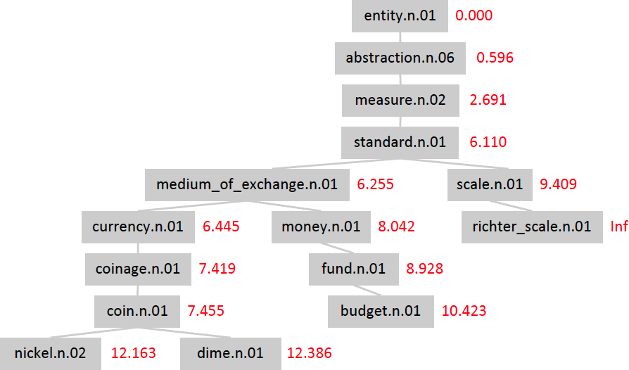
Example : Information content
Week 8, Lecture 2

Slide 36
Resnik Similarity
Resnik Similarity
Intuition: how similar two words are depends on how much they have in common
It measures the commonality by the information content of the lowest common subsumer
sim_{resnik}(c₁, c₂) = IC(LCS(c₁, c₂)) = −logP(LCS(c₁, c₂))
Week 8, Lecture 2

Slide 37
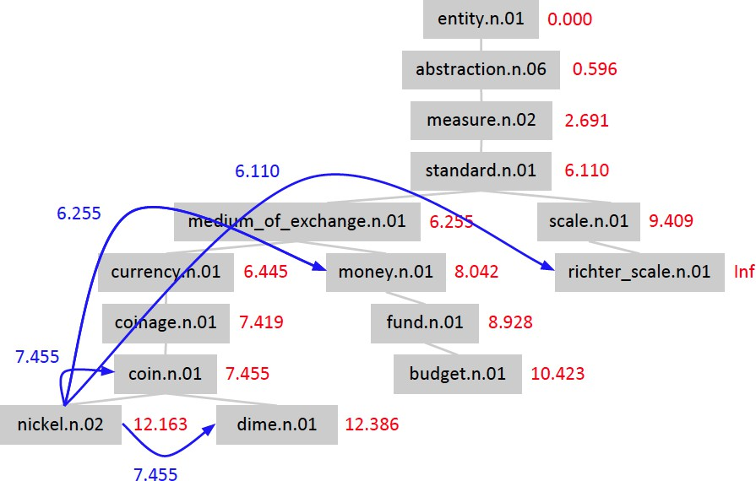
Example: Resnik similarity
Week 8, Lecture 2

Slide 38
Lin similarity
Proportion of shared information
It’s not just about commonalities - it’s also about differences!
Resnik: The more information content they share, the more similar they are
Lin: The more information content they don’t share, the less similar they are
Not the absolute quantity of shared information but the proportion of shared information
_{simLin(c1, c2) =} 2logP(LCS(c₁, c₂))
logP(c₁) + logP(c₂)
The information content common to c₁ and c₂, normalized by their average information content.
Week 8, Lecture 2

Slide 39

Example: Lin similarity
Week 8, Lecture 2

Slide 40
Jiang-Conrath distance
JC similarity
We can use IC to assign lengths to graph edges:
dist_{JC}(c, hypernym(c)) = IC(c) − IC(hypernym(c)) dist_{JC}(c₁, c₂) = dist_{JC}(c₁, LCS(c₁, c₂)) + dist_{JC}(c₂, LCS(c₁, c₂))
= IC(c₁) − IC(LCS(c₁, c₂)) + IC(c₂) − IC(LCS(c₁, c₂))
= IC(c₁) + IC(c₂) − 2 × IC(LCS(c₁, c₂))
sim_{JC}(c₁, c₂) = ¹
IC(c₁) + IC(c₂) − 2 × IC(LCS(c₁, c₂))
Week 8, Lecture 2

Slide 41

Example: Jiang-Conrath distance
Week 8, Lecture 2

Slide 42
The (extended) Lesk Algorithm
Two concepts are similar if their glosses contain similar words
Drawing paper: paper that is specially prepared for use in drafting
Decal: the art of transferring designs from specially prepared paper to a wood or glass or metal surface
For each n-word phrase that occurs in both glosses, add a score of n²
paper and specially prepared → 1 + 4 = 5
Week 8, Lecture 2
25 / 27

Slide 43
Problem in mapping words to wordnet senses
I saw a man who is 98 years old and can still walk and tell jokes
Week 8, Lecture 2

Slide 44
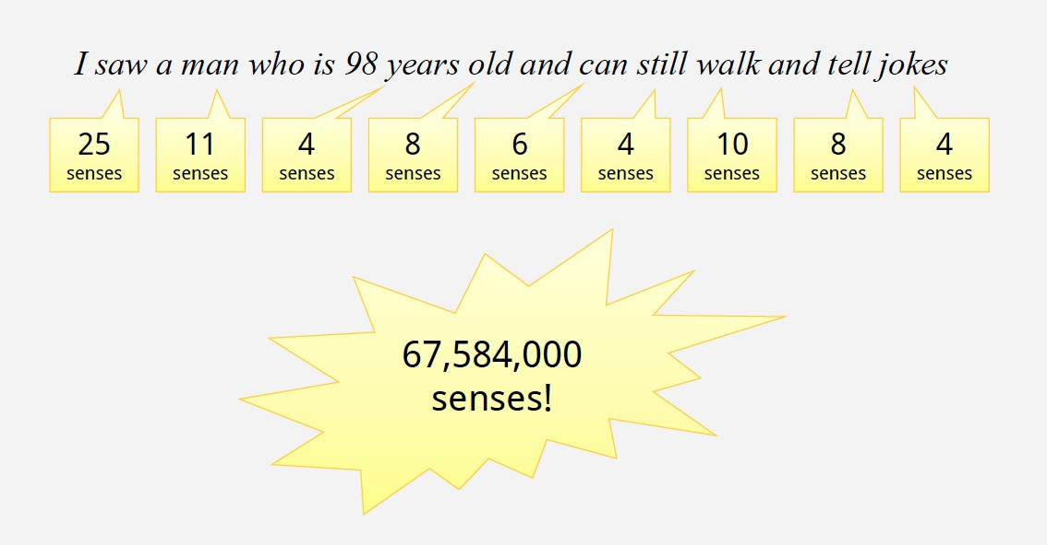
Ambiguity is rampant!
Week 8, Lecture 2

Slide 45
Word Sense Disambiguation - I
Week 8, Lecture 3

Slide 46
Word Sense Disambiguation (WSD)
Sense ambiguity
Many words have several meanings or senses
The meaning of bass depends on the context Are we talking about music, or fish?
An electric guitar and bass player stand off to one side, not really part of the scene, just as a sort of nod to gringo expectations perhaps.
And it all started when fishermen decided the striped bass in Lake Mead were too skinny.
Disambiguation
The task of disambiguation is to determine which of the senses of an ambiguous word is invoked in a particular use of the word.
This is done by looking at the context of the word’s use.
Week 8, Lecture 3
2 / 15

Slide 47
Algorithms
Knowledge Based Approaches
Overlap Based Approaches
Machine Learning Based Approaches
Supervised Approaches
Semi-supervised Algorithms
Unsupervised Algorithms
Hybrid Approaches
Week 8, Lecture 3

Slide 48
Knowledge Based Approaches
Overlap Based Approaches
Require a Machine Readable Dictionary (MRD).
Find the overlap between the features of different senses of an ambiguous word (sense bag) and the features of the words in its context (context bag).
The features could be sense definitions, example sentences, hypernyms etc.
The features could also be given weights.
The sense which has the maximum overlap is selected as the contextually appropriate sense.
Week 8, Lecture 3

Slide 49
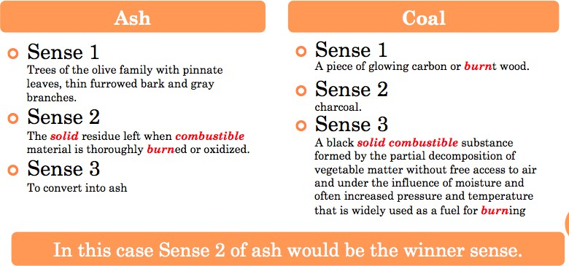
Lesk’s Algorithm
Sense Bag: contains the words in the definition of a candidate sense of the ambiguous word.
Context Bag: contains the words in the definition of each sense of each context word.
On burning coal we get ash.
Week 8, Lecture 3
5 / 15

Slide 50
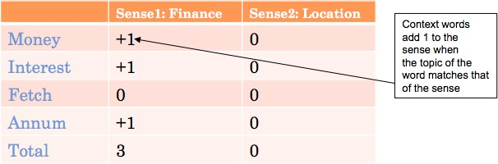
Walker’s Algorithm
A Thesaurus Based approach
Step 1: For each sense of the target word find the thesaurus category to which that sense belongs
Step 2: Calculate the score for each sense by using the context words. A context word will add 1 to the score of the sense if the thesaurus category of the word matches that of the sense.
E.g. The money in this bank fetches an interest of 8% per annum
Target word: bank
Clue words from the context: money, interest, annum, fetch
Week 8, Lecture 3
6 / 15

Slide 51
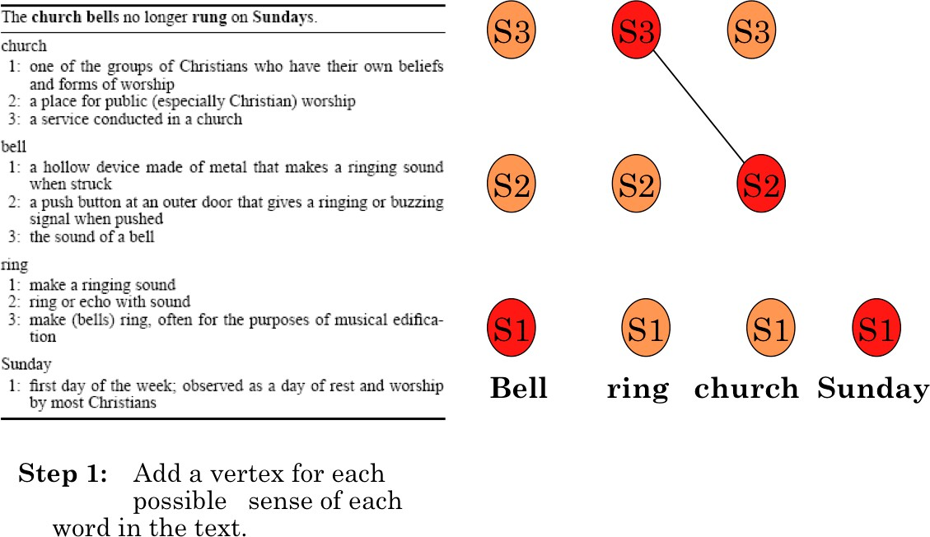
WSD Using Random Walk Algorithm
Week 8, Lecture 3

Slide 52
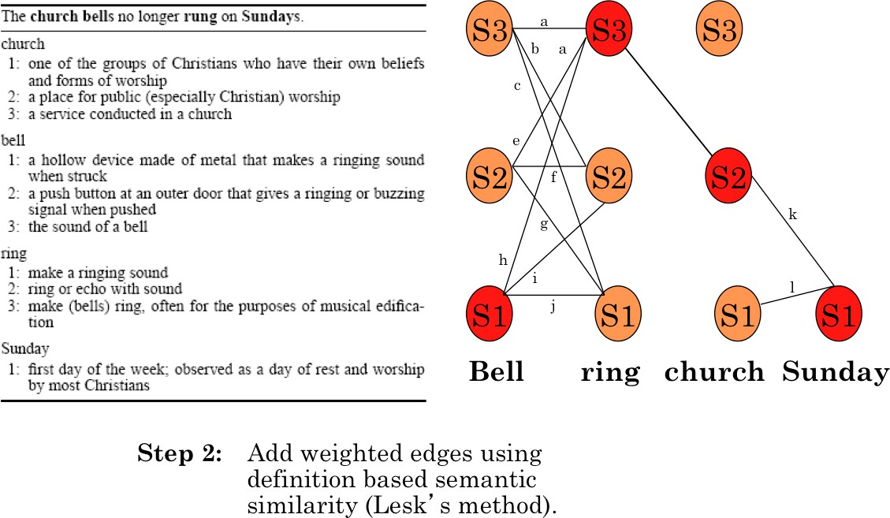
WSD Using Random Walk Algorithm
Week 8, Lecture 3

Slide 53
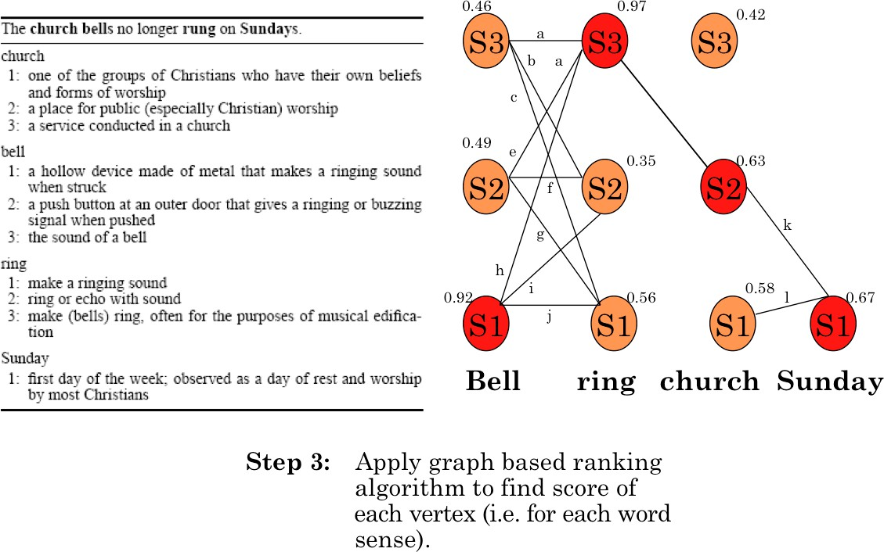
WSD Using Random Walk Algorithm
Week 8, Lecture 3

Slide 54
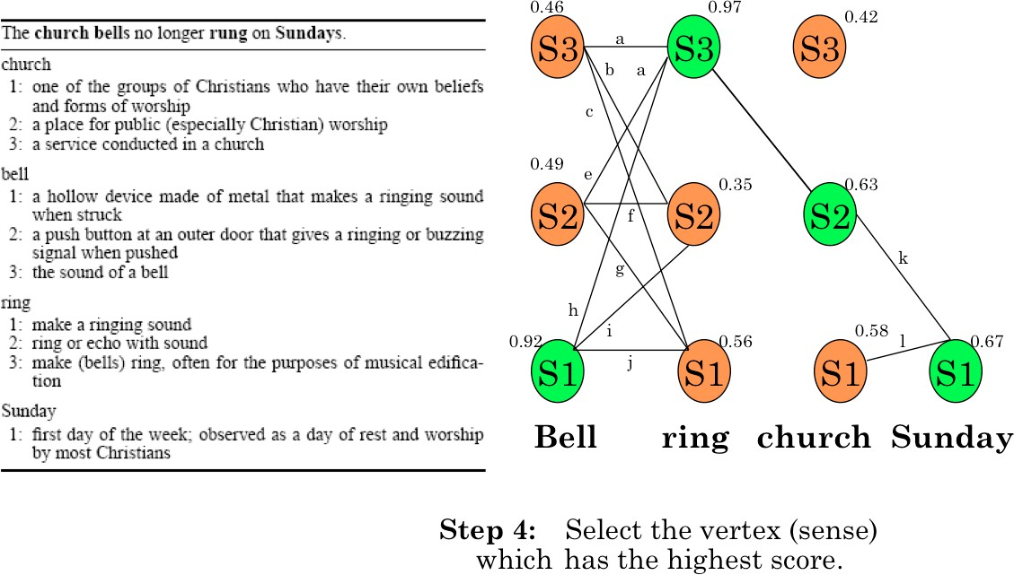
WSD Using Random Walk Algorithm
Week 8, Lecture 3

Slide 55
Naïve Bayes for WSD
A Naïve Bayes classifier chooses the most likely sense for a word given the features of the context:
ˆs = argmax P(s|f )
s∈S
Using Bayes’ law, this can be expressed as:
P(s)P(f |s)
ˆs = argmax
s∈S
P(f )
= argmax P(s)P(f |s)
s∈S
The ‘Naïve’ assumption: all the features are conditionally independent, given the sense’:
n
.
ˆs = argmax P(s) P
j=1
(f |s)
j
s∈S
Week 8, Lecture 3
11 / 15

Slide 56
Training for Naïve Bayes
‘f ’ is a feature vector consisting of:
POS of w
Semantic and Syntactic features of w
Collocation vector (set of words around it) → next word (+1), +2, -1, -2 and their POS’s
Co-occurrence vector
Set parameters of Naïve Bayes using maximum likelihood estimation (MLE) from training data
count(s_{i}, w_{j})
P(s ) =
i
count(w_{j})
count(f_{j}, s_{i})
P(f |s ) =
j i
count(s_{i})
Week 8, Lecture 3
12 / 15

Slide 57
Decision List Algorithm
Based on ‘One sense per collocation’ property
Nearby words provide strong and consistent clues as to the sense of a target word
Collect a large set of collocations for the ambiguous word
Calculate word-sense probability distributions for all such collocations Calculate the log-likelihood ratio
_{log(} P(Sense − A|Collocation_{i})₎ P(Sense − B|Collocation_{i})
Higher log-likelihood → more predictive evidence
Collocations are ordered in a decision list, with most predictive collocations ranked highest
Week 8, Lecture 3
13 / 15

Slide 58
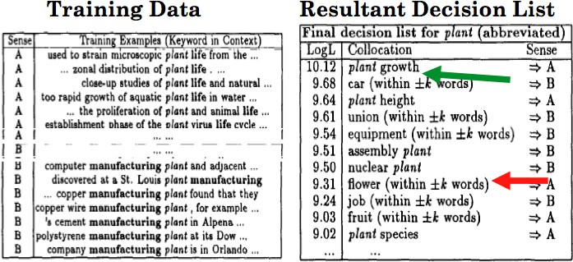
Decision List Algorithm
Classification of a test sentence is based on the highest ranking collocation, found in the test sentences.
plucking flowers affects plant growth.
Week 8, Lecture 3
14 / 15

Slide 59
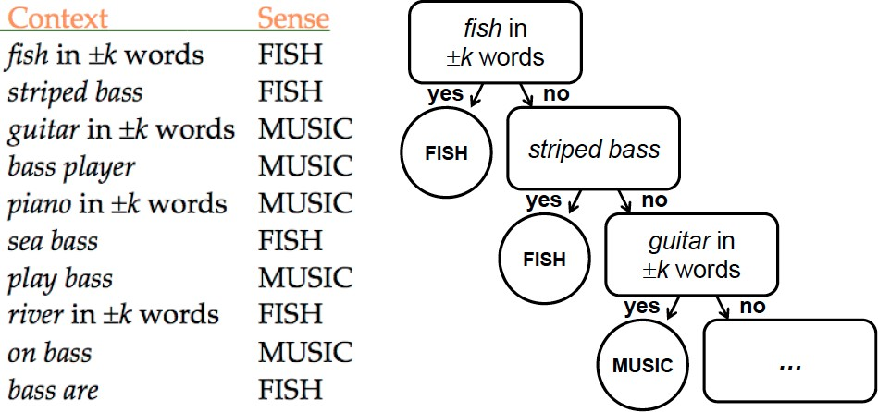
Example: discriminating between bass (fish) and bass (music):
Decision List: Example
Week 8, Lecture 3
15 / 15

